Slide 1

MOBILE APPS
Home
Team
About
Content
PRESENTATION
Academicpanel
Start Page
>

Slide 2




MEET THE
TEAM
Home
Team
About
Content
ARKO SIKDER
PRANTO DEV
Co-Supervisor
Supervisor
AL JAVIR
RADOAN RAHMAN
Developers
Developers
Next Page
>

Slide 3
Home
Team
About
Content
INTRODUCTION
  Problem:
    University systems are outdated, fragmented, and lack real-time updates. Students and faculty struggle with scattered information (SIMS, paper routines, email notices), causing delays and confusion.
  Solution:
    A centralized, dynamic Academic Panel mobile app that integrates schedules, exam routines, results, tuition info, announcements, and faculty data — all in one real-time dashboard.
  Key feature:
    User accounts (Student & Faculty)
    Course schedules
    Announcements & reminders
    Academic progress & results
    Show Payment & accounts information
    Lost and Found & Events section
Next Page
>

Slide 4



Home
Team
About
Content
TECHNOLOGY
Figma
Flutter
FireBase
Wireframes, UI design, prototypes
Cross-platform mobile app development
Realtime Database Firestore, Authentication
Next Page
>

Slide 5
WORK PROGRESS OVERVIEW
Home
About
Content
Team
  UI Design (Figma): Interactive prototypes for core system pages.
  Database Design (UML): Two modeling approaches – Class Diagram & Use Case Diagram.
  This ensures both the front-end user experience and the back-end structure are well aligned.
Next Page
>

Slide 6
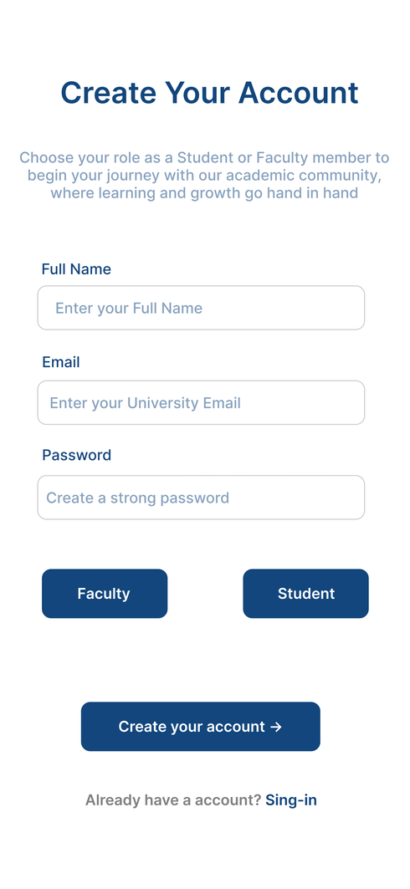
REGISTRATION PAGE (CREATE ACCOUNT)
Home
Team
About
Content
UI Design (Figma)
  Purpose: Allows a new user (Student or Faculty) to create an account in the system.
  Features:
    Enter Full Name
    Enter Email (University email required)
    Create a Password
    Choose Role → Student or Faculty
  Why important: This page ensures only verified users become part of the academic community.
Sign Up

Slide 7
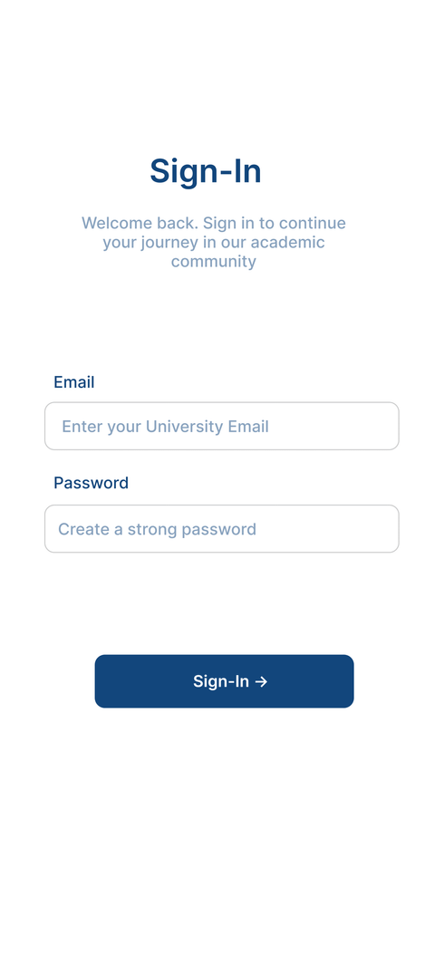
LOGIN PAGE (SIGN-IN)
Home
Team
About
Content
UI Design (Figma)
Purpose: Gives registered users access to the system.
Features:
  Enter Email & Password
  “Sign-In” button to authenticate and open the dashboard
Why important: Provides secure access and protects user data.
Sign In

Slide 8
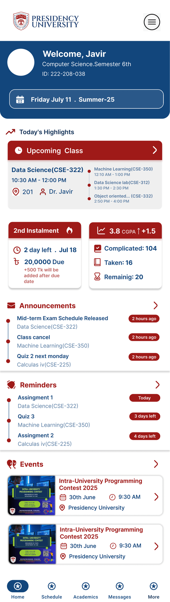
DASHBOARD / HOME PAGE
Home
Team
About
Content
UI Design (Figma)
Purpose: Central hub for all important updates and quick navigation.
Features:
  Welcome message with Student details (Name, ID, Semester)
  Announcements (e.g., class cancellations, quiz dates)
  Reminders (deadlines, payments, events)
  Events section (upcoming university activities)
Why important: Keeps users informed about academics and campus life at a glance.
Home page ( vertical Scrollable)

Slide 9
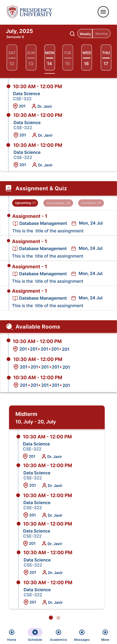
SCHEDULE PAGE
Home
Team
About
Content
UI Design (Figma)
Purpose: Displays daily, weekly, and monthly class, Exam and Assignment schedules and available room in that period.
Features:
  Class timing and Course details (Course code, name, teacher, room)
  Calendar layout (Monthly & Weekly views)
  Highlights for Upcoming & Ongoing classes, exam and assignment
  available room
Why important: Helps students and faculty manage time effectively.
schedule page ( vertical Scrollable)

Slide 10
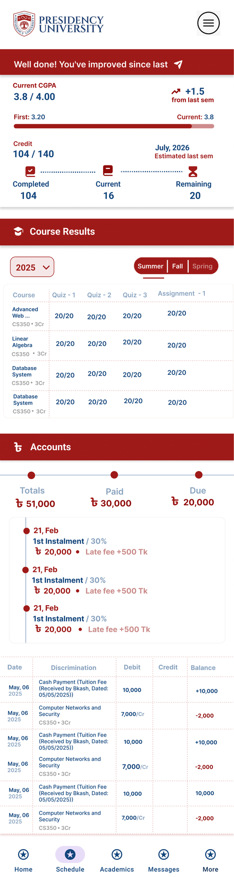
ACADEMICS AND ACCOUNTS PAGE
Home
Team
About
Content
UI Design (Figma)
Purpose: Shows course grades and overall CGP and Manages tuition fees.
Features:
  Course-wise results (Assignments, Quizzes, Exams)
  GPA calculation and progress tracking
  Comparison of past vs current semester performance
  Tuition fees breakdown (Total, Paid, Due)
  Payment history (e.g., Bkash payments, dates)
  Late fee alerts (+500 Tk if overdue)
Why important: Motivates students by showing improvements and tracking progress.
Academic page ( vertical Scrollable)

Slide 11
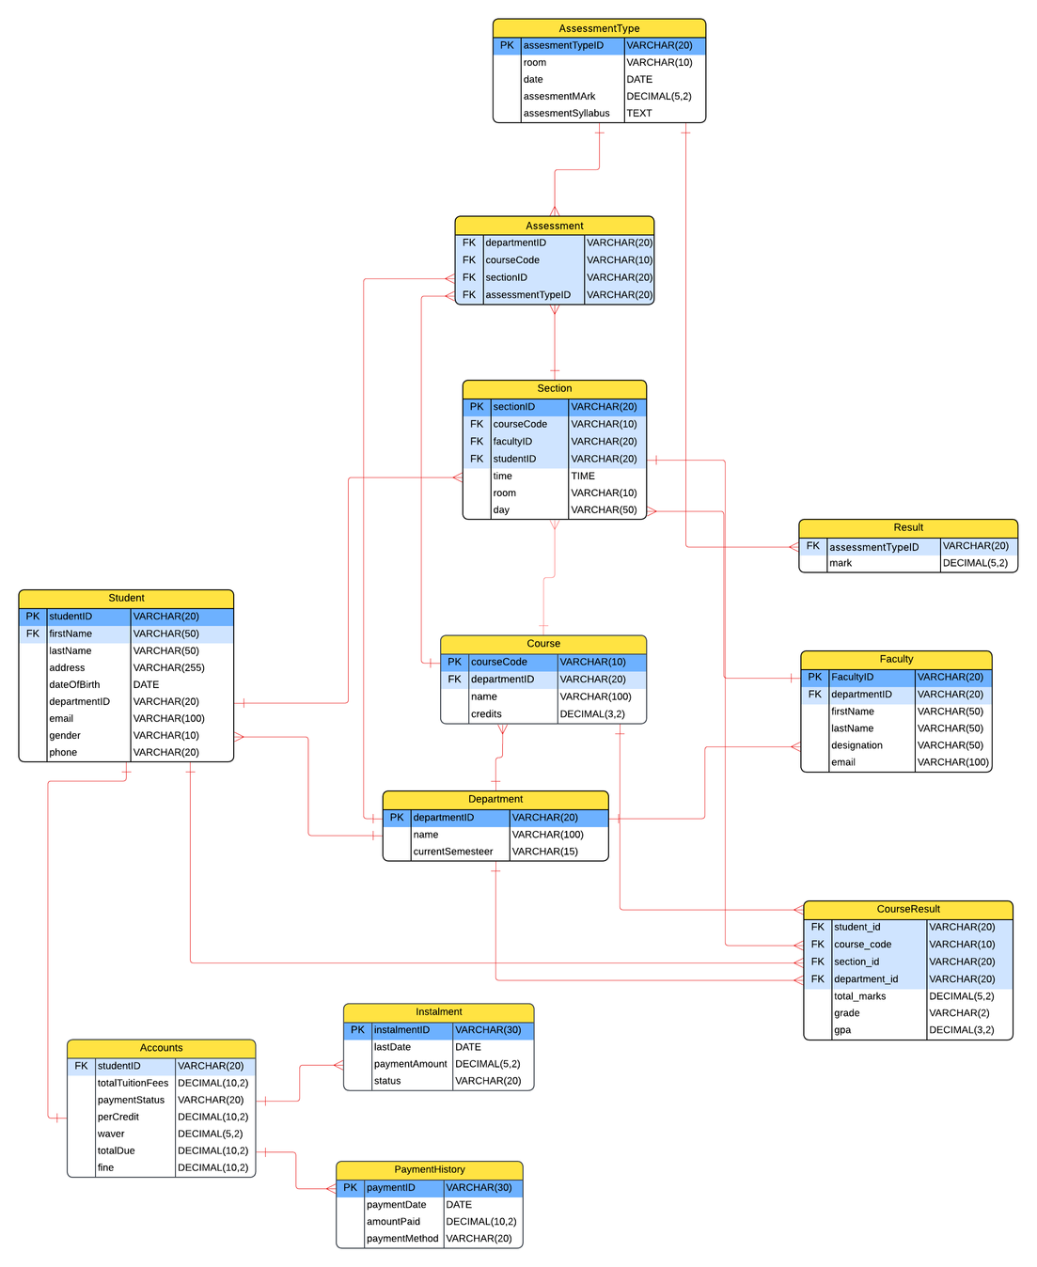
UML CLASS DIAGRAM
Home
Team
About
Content
Database Design
  Student: Basic student info (ID, name, contact, DOB, gender, department).
  Faculty: Faculty details (name, designation, email, department).
  Department: Academic unit that manages students, faculty, courses, and current semester.
  Course: Course details (code, name, credit hours) under a department.
  Section: Specific offering of a course in a semester (faculty, schedule, room).
  AssessmentType: Defines evaluation types (quiz, midterm, final, assignment) with date, room, max marks, syllabus.
  Assessment: Connects assessment types to sections, defining which assessments are used in a section.
  Result: Stores a student's marks for each assessment in a section.
  CourseResult: Final summary of a student’s performance in a section (total marks, grade, GPA).
  Accounts: Financial record for each student (tuition, dues, waiver, balance, payment status).
  Installment: Tracks installment-based payments (amount, due date, status).
  PaymentHistory: Logs each payment made by a student (date, amount, method).
Entity

Slide 12
UML CLASS DIAGRAM
Home
Team
About
Content
Database Design
  A department manages many students, faculty, and courses.
  A course belongs to one department and has multiple sections.
  A faculty member teach multiple sections.
  A student enrolls in multiple sections and receives assessment results.
  AssessmentType defines standardized assessment categories.
  Assessment links a section with an assessment type.
  Result stores marks for each student per assessment.
  CourseResult summarizes overall student performance for a section.
  Each student has one account.
  Accounts contain multiple installments, each with multiple payment history records.
Relationship

Slide 13
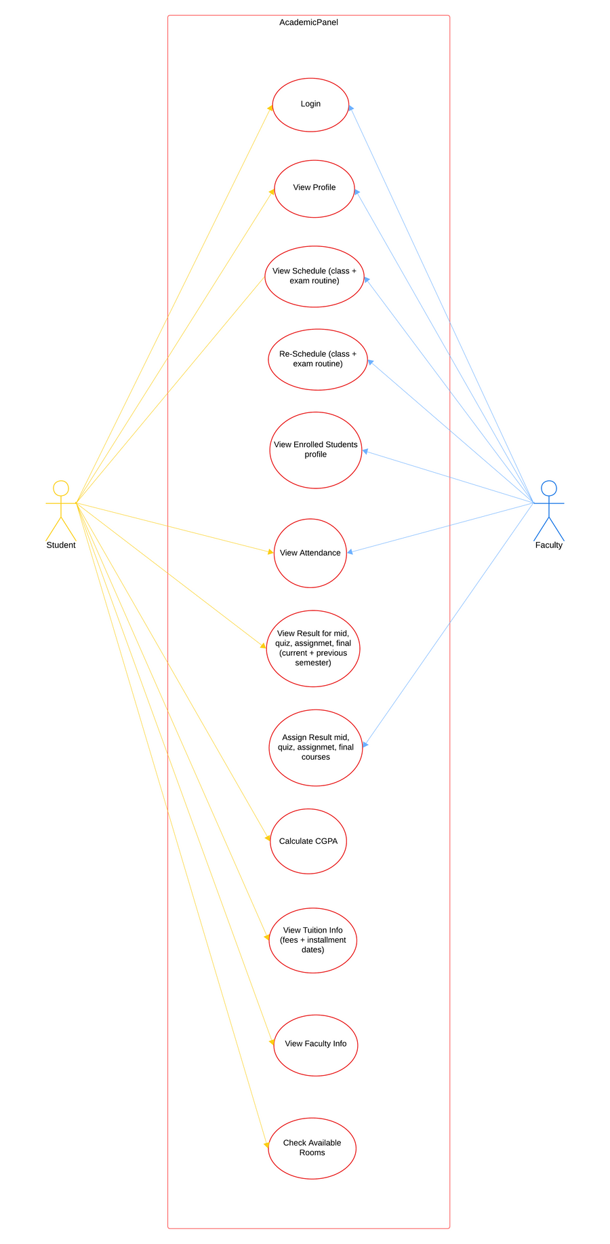
UML CASE DIAGRAM
Home
Team
About
Content
Database Design
Student Use Cases:
  Login & View Profile
  View Schedule (class + exam routine)
  View Attendance
  View Results (quiz, mid, assignment, final – current + previous semesters)
  Calculate CGPA
  View Tuition Info (fees + installment dates)
  View Faculty Info
  Check Available Rooms
  View faculty info
Faculty Use Cases:
  Login & View Profile
  View and Reschedule Schedules
  View Attendance
  Assign Results for mid, quiz, assignment, and final
  View Enrolled Students’ Profiles

Slide 14
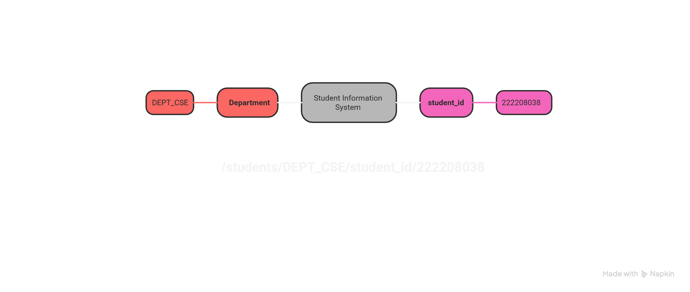
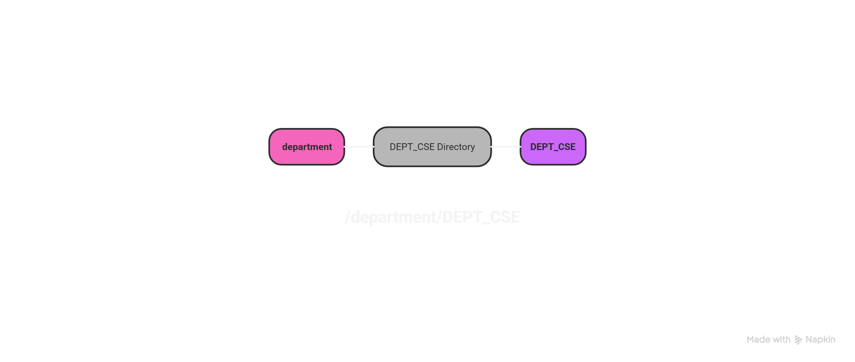
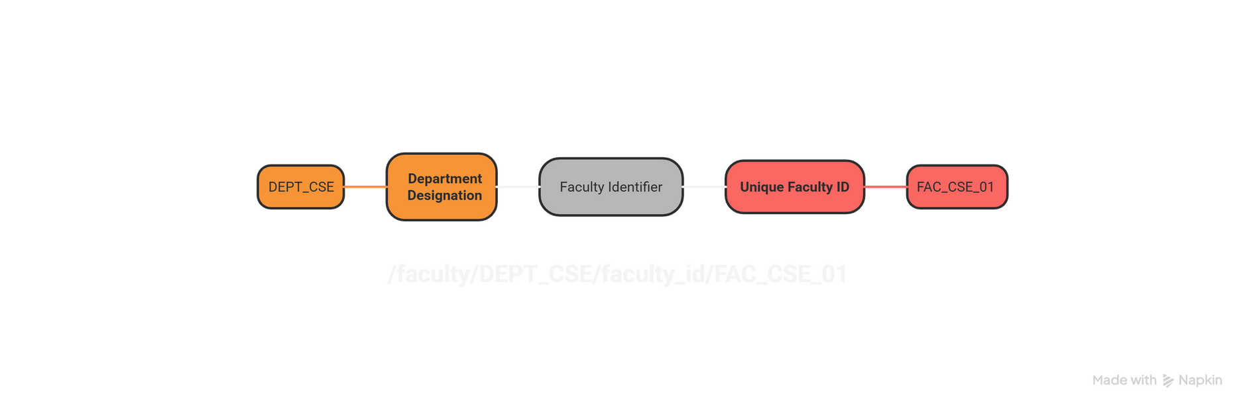
FIREBASE REAL TIME DATABASE
Home
Team
About
Content
Database Structure
Student
Department
Faculty

Slide 15
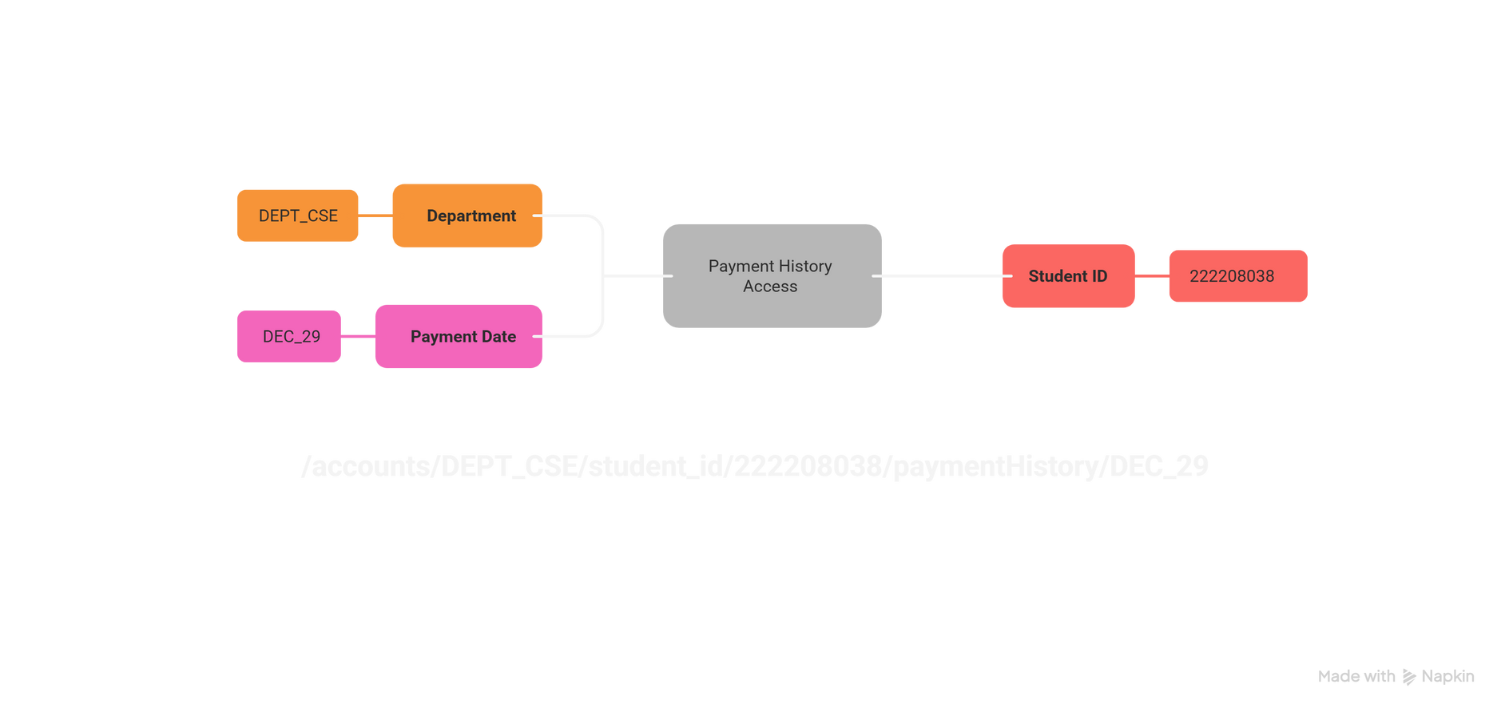
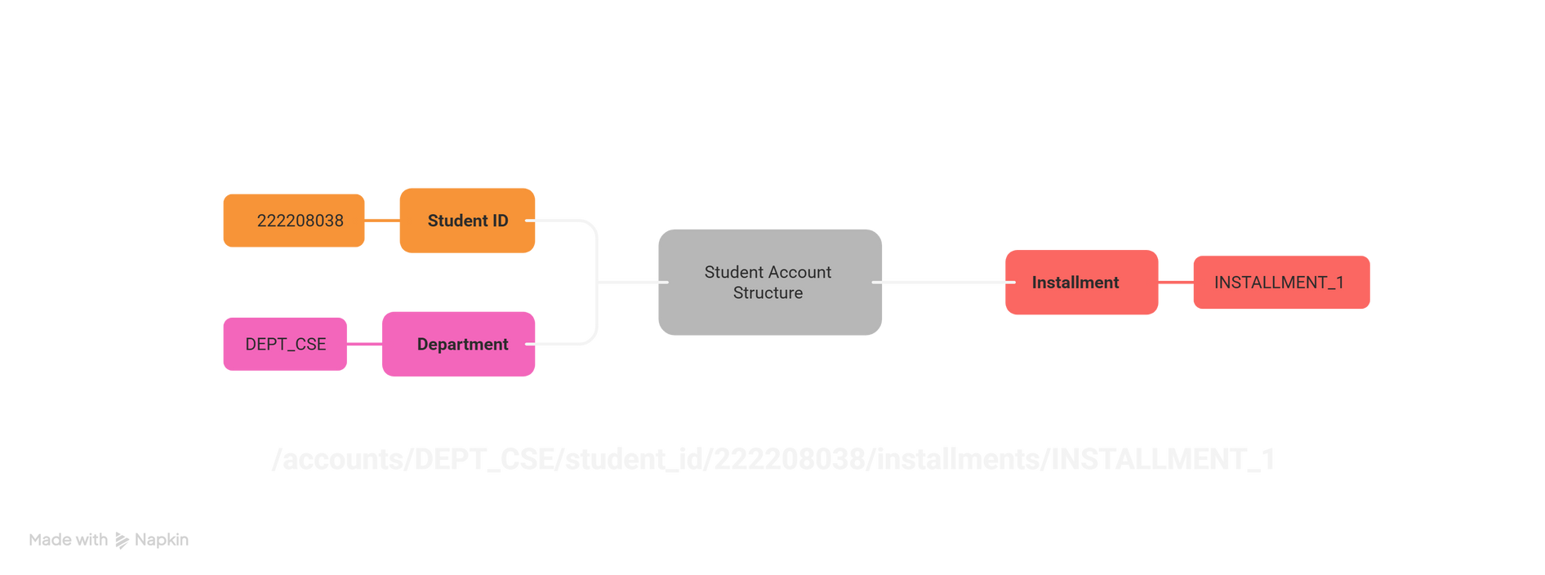
FIREBASE REAL TIME DATABASE
Home
Team
About
Content
Database Structure
Accounts/paymentHistory
Accounts/installment

Slide 16
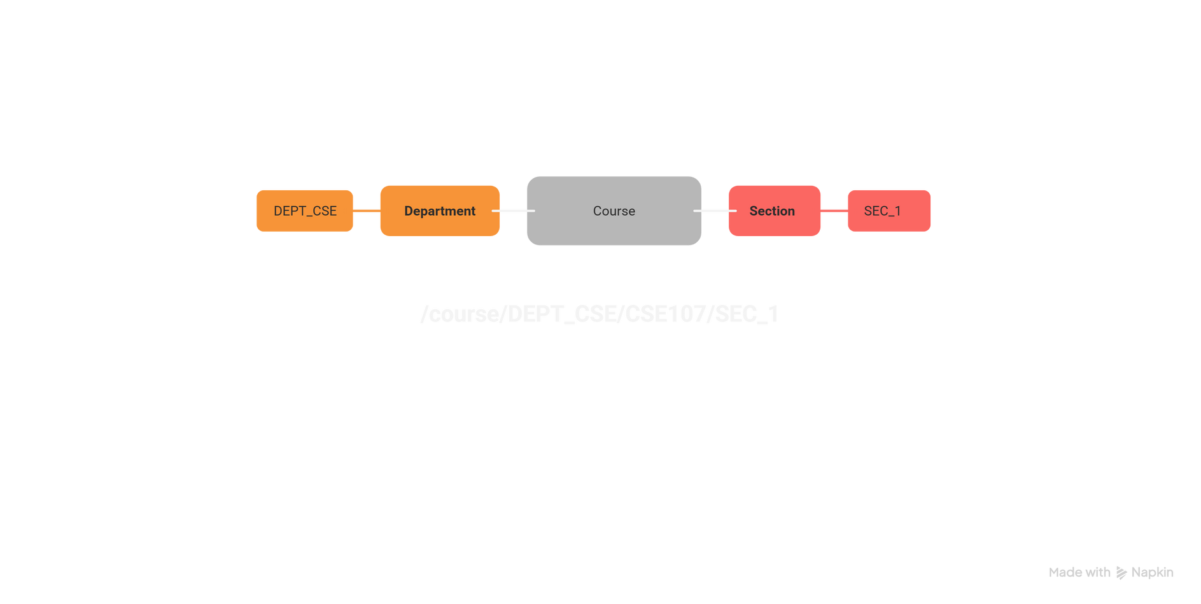
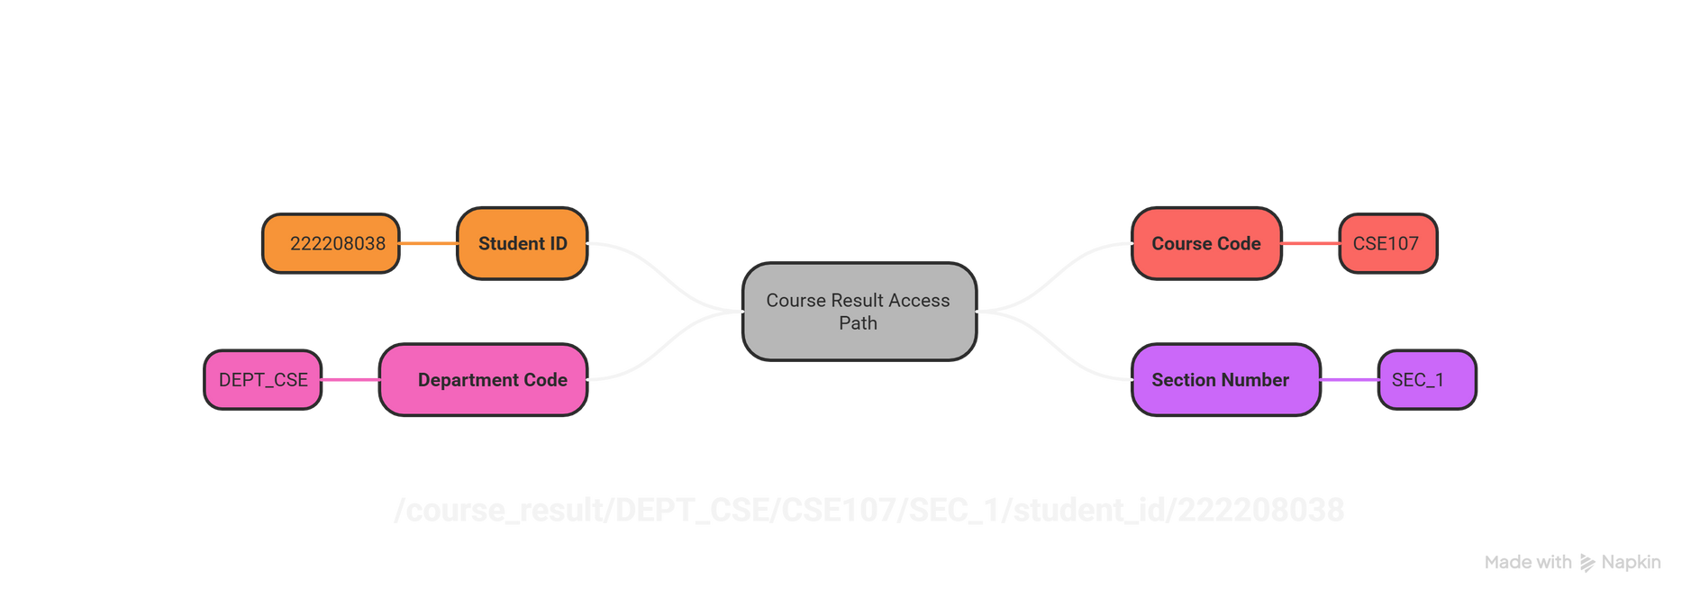
FIREBASE REAL TIME DATABASE
Home
Team
About
Content
Database Structure
Course
Course Result

Slide 17
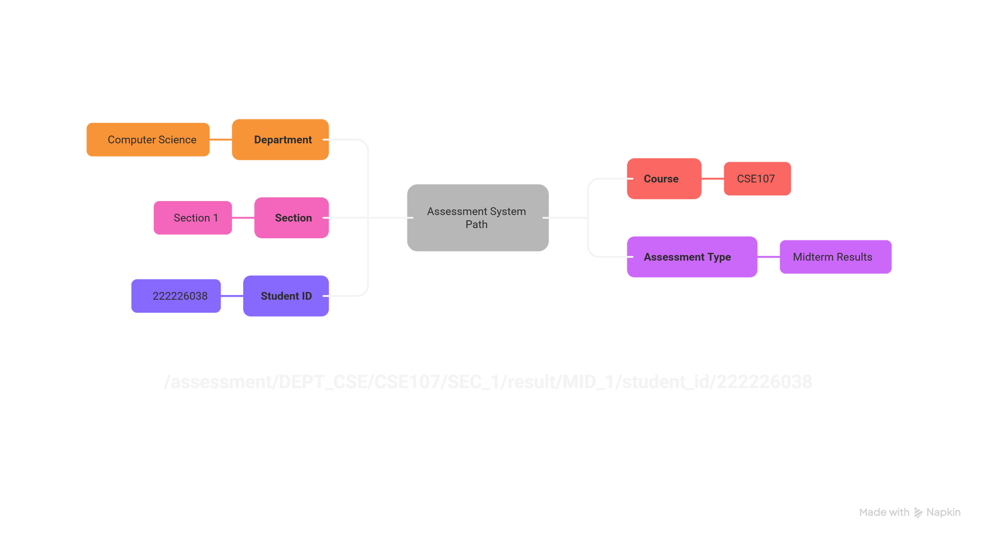
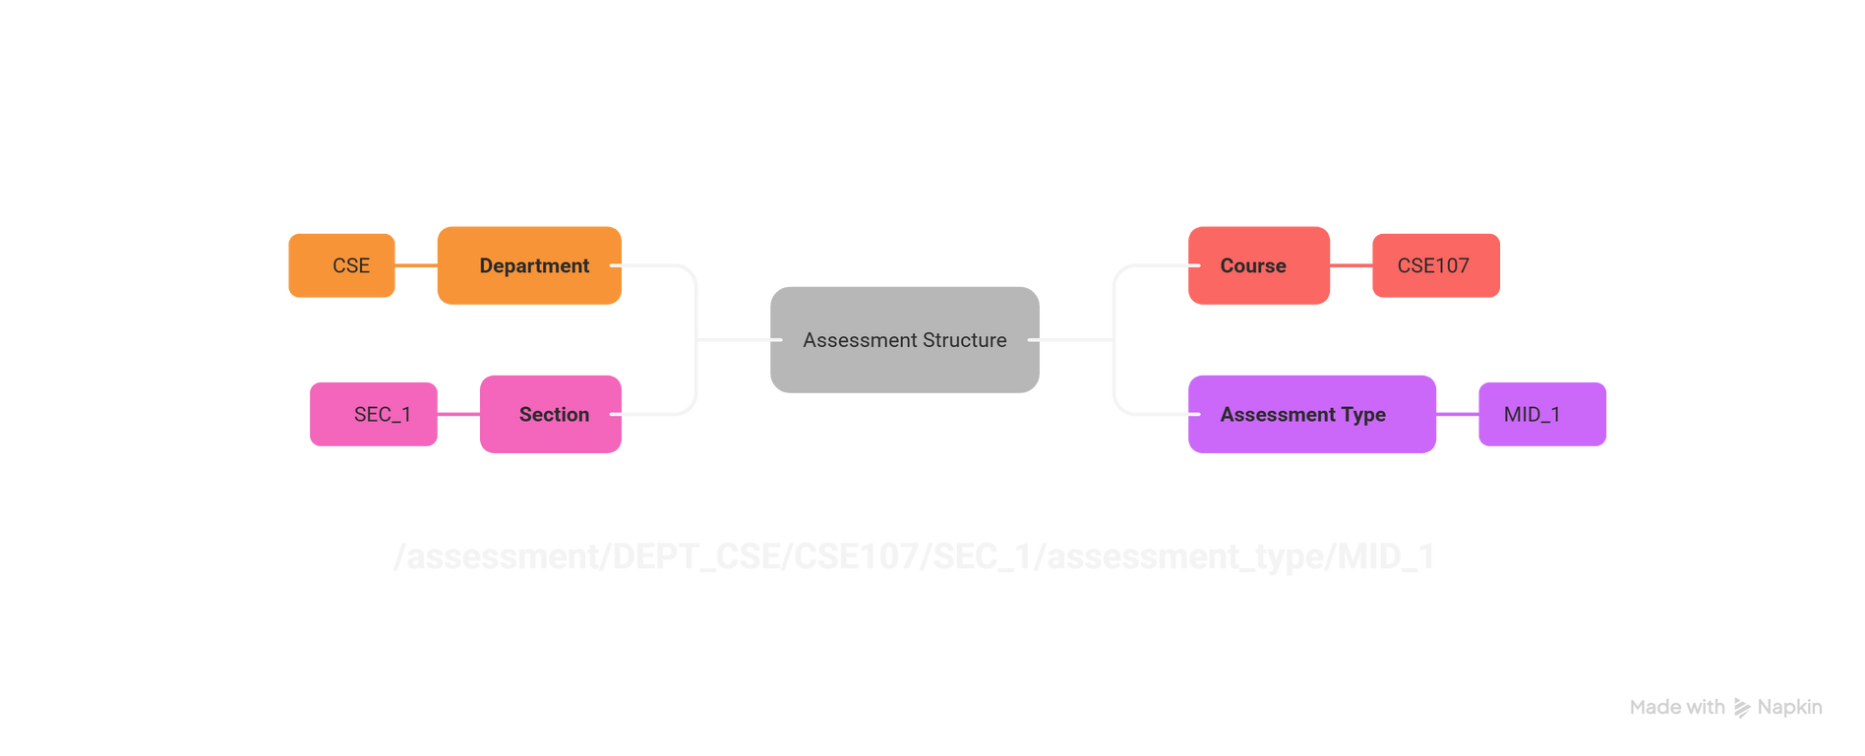
FIREBASE REAL TIME DATABASE
Home
Team
About
Content
Database Structure
Assessment/result
Assessment/type

Slide 18
Home
Team
About
Content
THANK YOU
>
Back To Home

